Slide 1
Capstone Project
The Battle of Neighbourhoods
Open a Mediterranean food restaurant in Toronto
IBM Data Science Professional Certificate – Course 9
Narciso López López

Slide 2
1. Introduction
Growing immigration from many countries around the world to Canada in the last decade has increased globalization in different cities. Specifically, in the city of Toronto, restaurants of different nationalities have opened, including Chinese, Japanese, Indian, among others.
The objective of this project is to find out if among all these gastronomies of the world, there is a place in Toronto for the famous "Mediterranean gastronomy". It is well known that Mediterranean gastronomy is one of the healthiest in the world because it uses among its main ingredients fresh and quality products, such as vegetables, fruits, virgin olive oil, etc.
Thanks to this project, we will be able to know if opening a Mediterranean cuisine restaurant in Toronto is a viable project or not. This project may be useful for entrepreneurs who are looking to invest in a restaurant in a neighborhood in Toronto. On the other hand, the target audience will be all people who have an exquisite palate and want to taste the flavors of Mediterranean cuisine.

Slide 3
2. Data description
We will use the dataset obtained in week. This contains the latitudes, longitudes and zip codes of Canada. This dataset can be found in: https://en.wikipedia.org/wiki/List_of_postal_codes_of_Canada:_M
Foursquare API Data
To get the data for the different neighborhoods of Toronto in Canada, we will use the Foursquare API. As in week 3 of the course, we will get location information of the venues.
The data obtained from Foursquare are: Neighborhood, Neighborhood latitude, Neighborhood Longitude, Venue, Name of the Venue, Venue latitude, Venue longitude, and Venue category.

Slide 4
2. Data description
Libraries:
Pandas: to create and manipulate dataframes.
Scikit learn: to use k-means clustering.
Numpy: to support the creation of multidimensional arrays and vectors.
Matplotlib: to create plots.
Geocoder: to retrieve location data.
Folium: map rendering library.
JSON: to handle JSON files.
Requests: to handle requests.
Unsupervised machine learning
For this project we will use the unsupervised learning algorithm k-means to segment and cluster the data and thus obtain enough information to know in which place is more appropriate to open a restaurant of Mediterranean gastronomy.

Slide 5
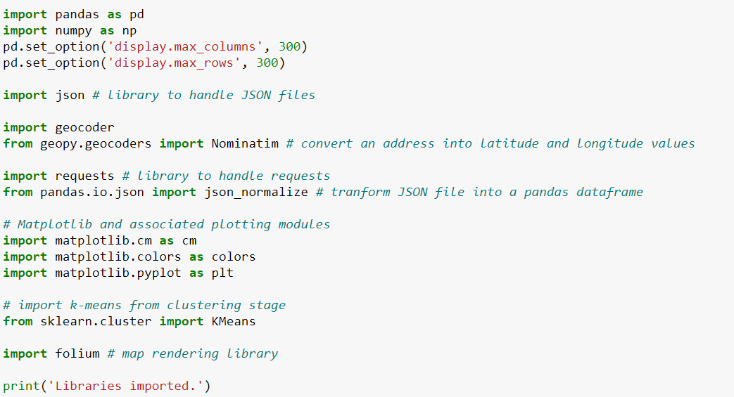
3. Methodology
Importing required libraries

Slide 6
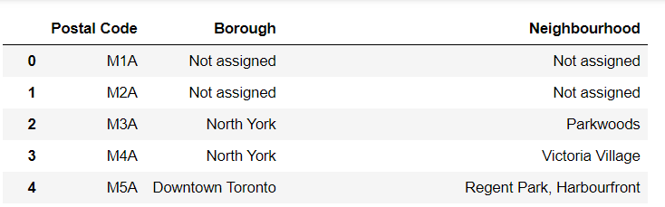
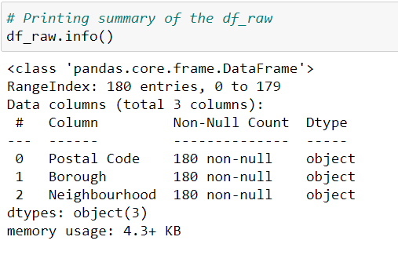
3. Methodology
Reading the data and importing it into the dataframe (Data Collection)

Slide 7

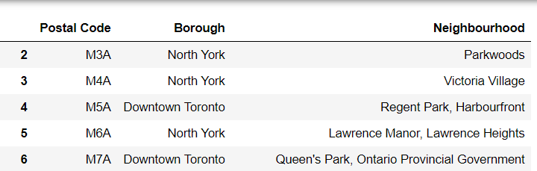
3. Methodology
Only process the cells that have an assigned borough. Ignore cells with a borough that is not assigned.

Slide 8
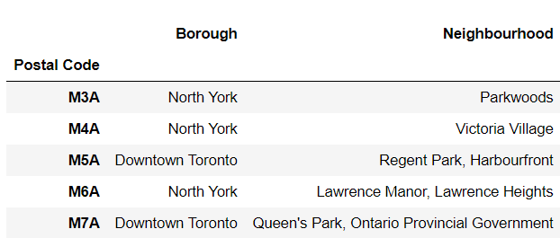
3. Methodology
More than one neighborhood can exist in one postal code area. For example, in the table on the Wikipedia page, you will notice that M5A is listed twice and has two neighborhoods: Harbourfront and Regent Park. These two rows will be combined into one row with the neighborhoods separated with a comma.

Slide 9
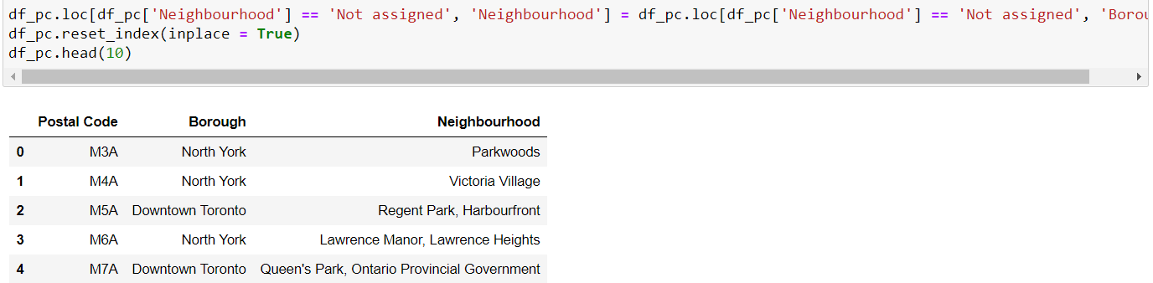
3. Methodology
If a cell has a borough but a not assigned neighborhood, then the neighborhood will be the same as the borough.

Slide 10
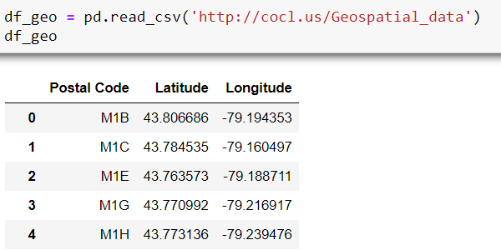
3. Methodology
Reading geospatial data

Slide 11
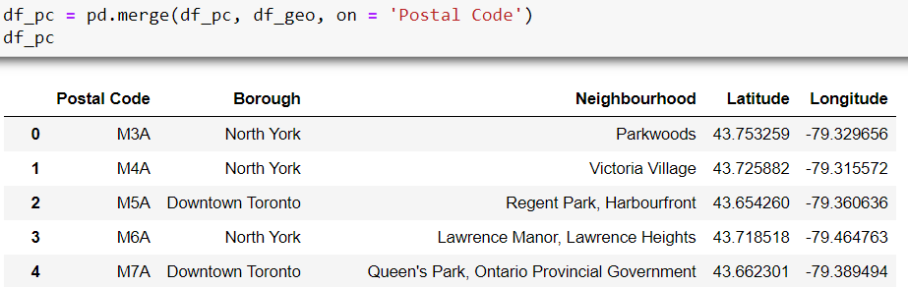
3. Methodology
Merging both dfs by Postal Code

Slide 12
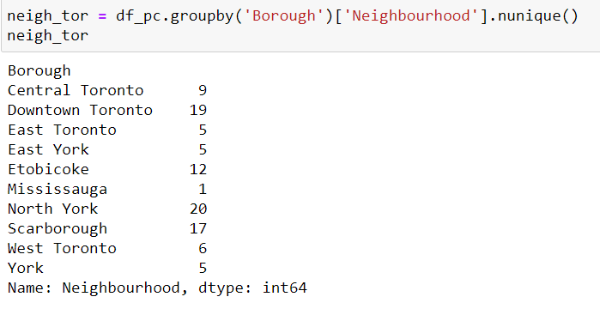
3. Methodology
Data Visualization
Exploratory Data Analysis to understand better how many neighborhoods are.

Slide 13
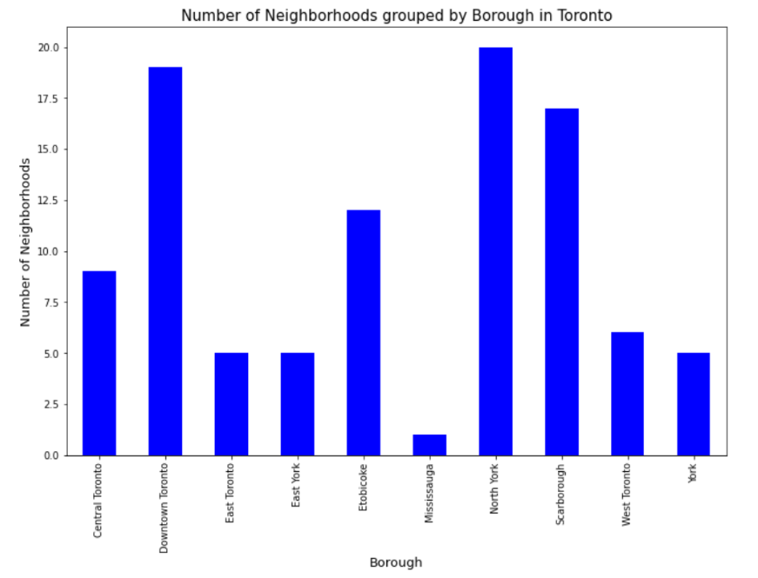
3. Methodology
Plotting the data
North York is the borough with the greatest number of neighborhoods. Downtown Toronto is the borough with the second largest number of neighborhoods.

Slide 14
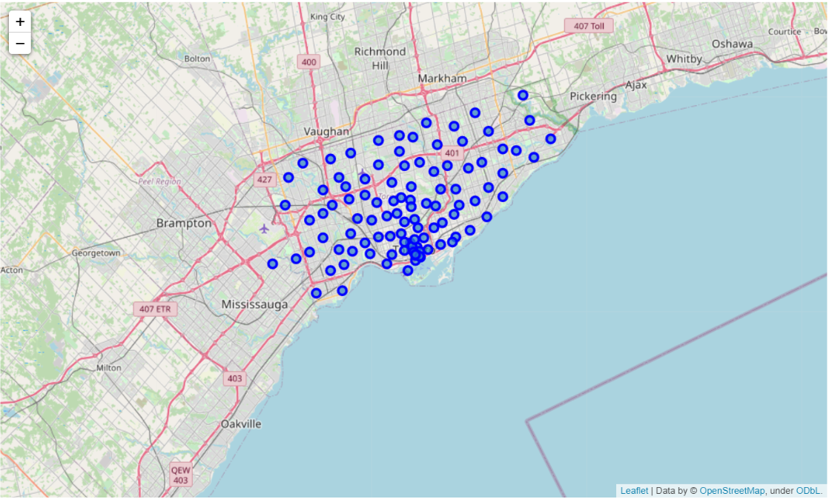
3. Methodology
Using Foursquare API
Create a map of Toronto with neighborhoods superimposed on top

Slide 15
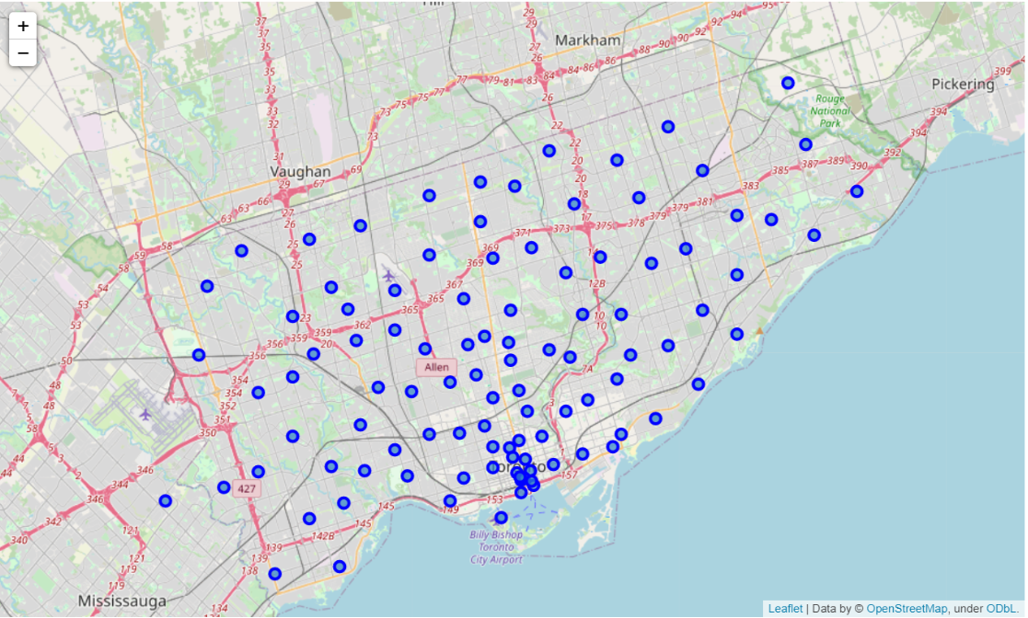
3. Methodology
Using Foursquare API
Create a map of Toronto with neighborhoods superimposed on top

Slide 16
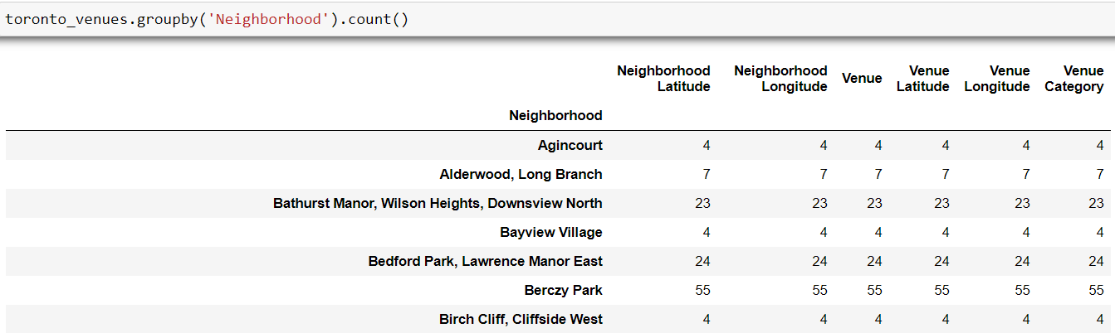
3. Methodology
Explore Neighborhoods in Toronto
How many venues were returned for each neighborhood.

Slide 17
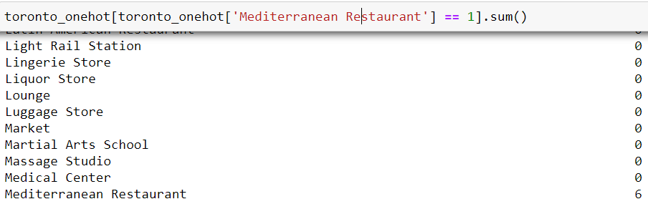
3. Methodology
Analyze Each Neighborhood
Mediterranean restaurants.

Slide 18
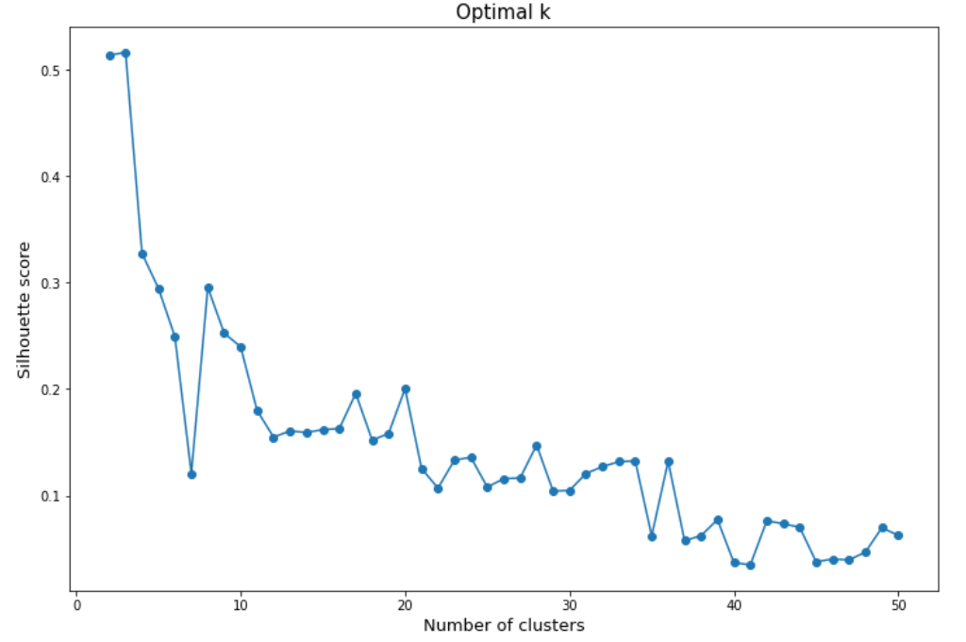
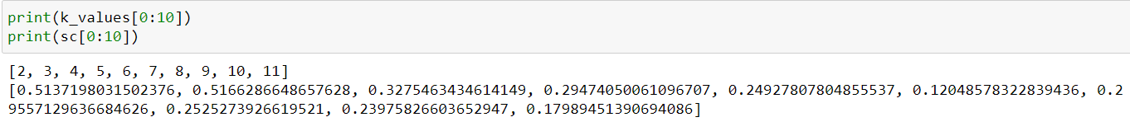
3. Methodology
Cluster Neighborhoods
Plotting Silhouette score with different number of clusters

Slide 19
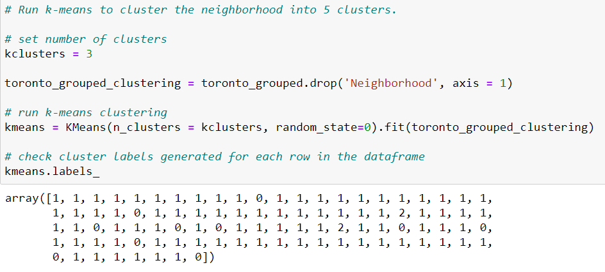
3. Methodology
Cluster Neighborhoods
Taking into account the results of the silhouette score, we will use 3 clusters for our clustering model as this is the best result obtained.

Slide 20
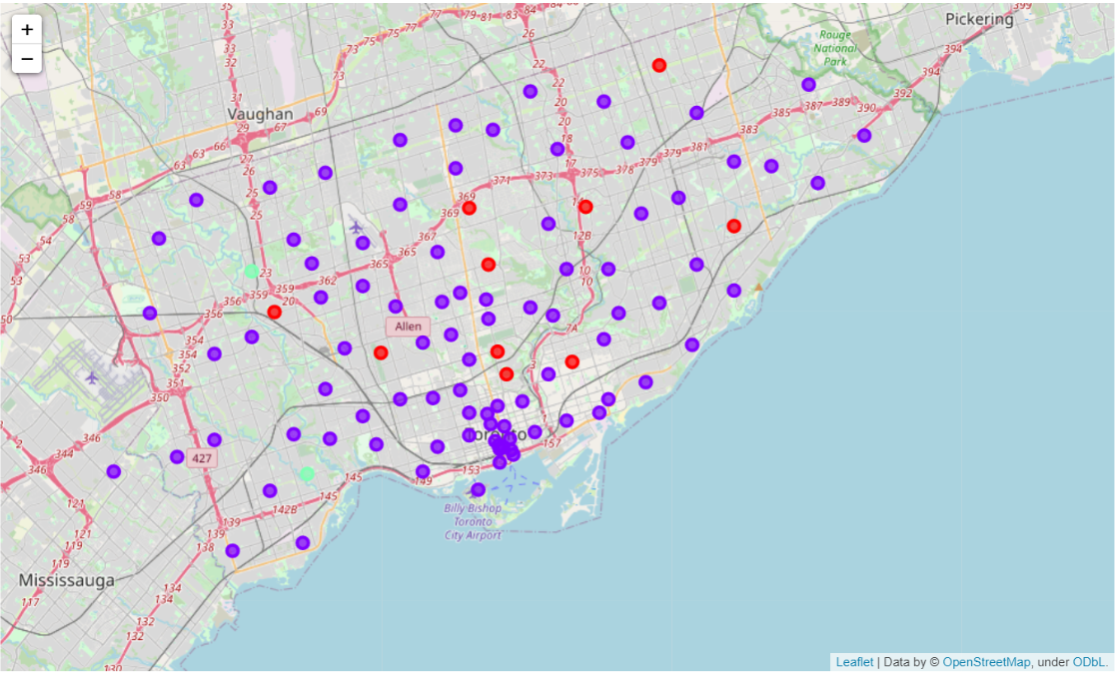
3. Methodology
Cluster Neighborhoods
Finally, let's visualize the resulting clusters

Slide 21
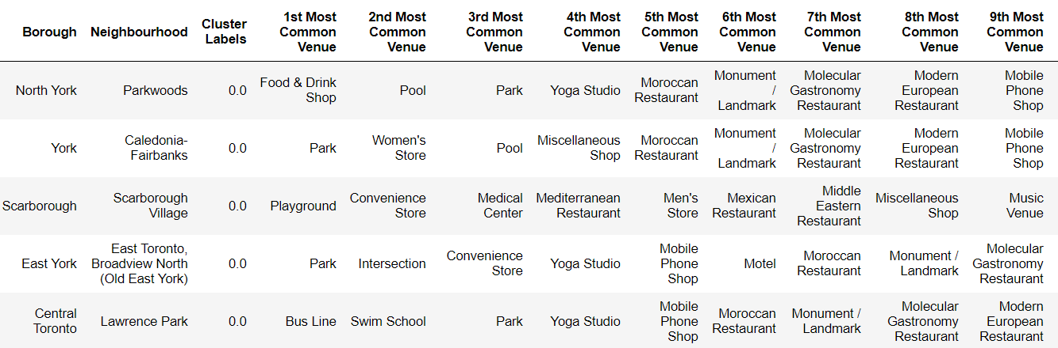
3. Methodology
Cluster Neighborhoods
Examine Cluster 1

Slide 22
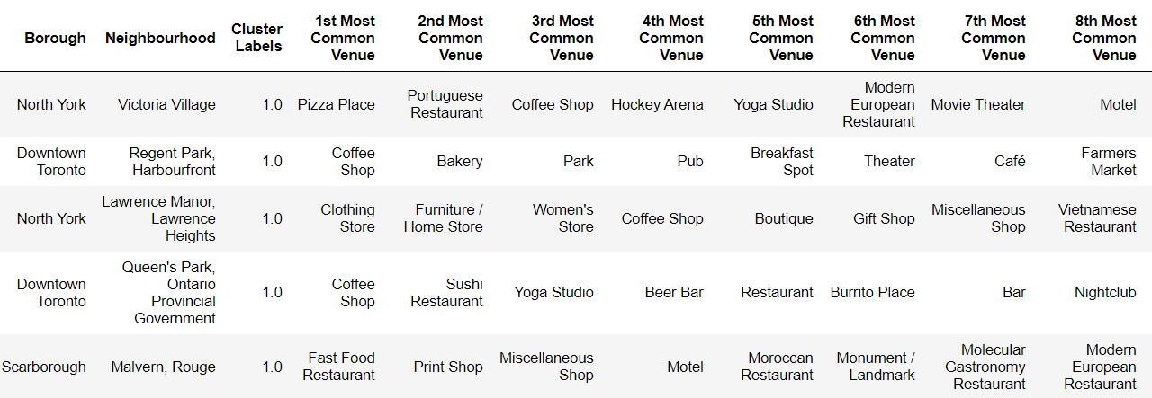
3. Methodology
Cluster Neighborhoods
Examine Cluster 2

Slide 23
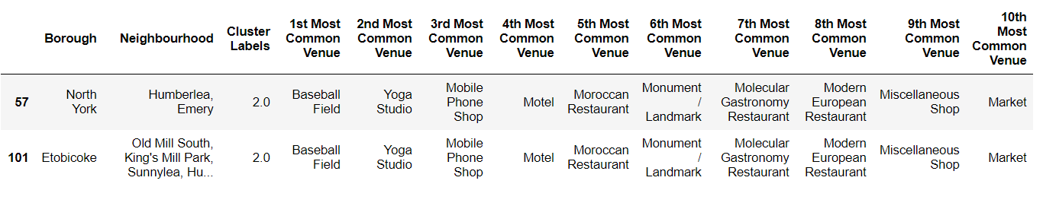
3. Methodology
Cluster Neighborhoods
Examine Cluster 3

Slide 24
4. Results
The results show 3 clusters in the city of Toronto in Canada.
We have searched for the 10 most common venues for each of the clusters obtained. It can be observed that some clusters are more suitable for having a restaurant.
Cluster 1 contains 9 observations. These observations belong to 6 boroughs and we see that in none of the 3 most common venues a restaurant appears.
Cluster 2 is the cluster with the highest number of observations and therefore also has the highest number of restaurants among the 10 most common venues.
Finally, cluster 3 has the lowest number of observations. Therefore, the number of restaurants is also much lower compared to the other two clusters. However, the top 2 venues show that baseball field and yoga studio are the most common.

Slide 25
5. Discussion
Analyzing the 3 clusters we can conclude that clusters 1 and 2 are the most appropriate when opening a restaurant, specifically, in our case, a Mediterranean food restaurant.
For cluster 1, we observed Mediterranean food restaurants in the boroughs of Scarborough and Central Toronto, so establishing our restaurant in those boroughs would be the most appropriate for our business.
Cluster 2 is the cluster that contains the most neighborhoods in the city of Toronto, with a total of 84 neighborhoods. In particular, the Hillcrest Village neighborhood, belonging to the borough of North York, has Mediterranean food restaurants in the third place.
It is worth mentioning that the boroughs of Etobicoke, Scarborough, and York would also be good options to open the restaurant as they also have Mediterranean cuisine.
Finally, cluster 3 would not be an option when it comes to opening our restaurant because as seen in these neighborhoods, they are more inclined to healthy living as the most common venues. Although it seems that Moroccan food has also had a good acceptance.

Slide 26
6. Conclusion
We have successfully analyzed the neighborhoods of Toronto, Canada, to determine which would be the most suitable neighborhood to open our Mediterranean cuisine restaurant.
Taking into account the analysis and the results obtained, the most propitious neighborhood is Hillcrest Village, located in the borough of North York, since it has a restaurant of this style among the 3 most common venues.
On the other hand, as a future work, it would be good to know other factors such as associated costs or transportation. These were not considered because they were out of scope.

Slide 27
Capstone Project
The Battle of Neighbourhoods
Open a Mediterranean food restaurant in Toronto
IBM Data Science Professional Certificate – Course 9
Narciso López López

